Slide 1

ASP.NET MVC Bootstrapper
developers-organism.com
info@developers-organism.com
Instructor
Alim Ul Karim
Sponsored by:
alim@developers-organism.com
WeReviewApp.com
Play List
Comparison
Features

Slide 2
Introduction
Get it from github.
ASP.NET MVC Boostratpper : An opensource enterprise framework and project template.

Slide 3
Introduction
Get it from github.
ASP.NET MVC Boostratpper : An opensource enterprise framework and project template.

Slide 4
Share
Like

Slide 5
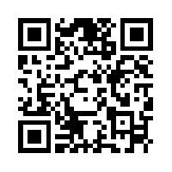

/groups/c.prog.alim
Stay tuned

Slide 6
Dislike + Comments

Slide 7
Thank you for watching
Questions ?
Instructor
Alim Ul Karim
alim@developers-organism.com

Slide 8


Find us
/DevelopersOrganism
developers-organism.com
info@developers-organism.com

